Slide 1
Behavioural Skills and
Professional Communication
IV Year B.Tech. I Semester
Open Elective
V. Jahnavi
Senior Assistant Professor, Student Counsellor
Humanities & Mathematics Department, GNITS

Slide 2
UNIT 1
LIFE SKILLS

Slide 3
1. What is Behaviour?
It is the way in which an organism behaves as a response towards a particular situation or stimulus.
What is Skill?
It is the ability to coordinate mind, thought and body which can developed through training.

Slide 4
Behavioural Skills
A balanced action or response of a person in different situations that enhances the effectiveness of interpersonal relationships along with organization of lifestyle.
They are people skills that which include social and emotional skills that allow people to work and perform well in organizations and in the society.
Based on Behavioural psychology, Social Emotional Learning and Action based experiential learning methodology.

Slide 5
Essential Behavioural Skills
Here are the top 10 behavioral skills for students and employees:
Communication
Conflict Resolution
Self Improvement
Time Management
Stress Management
Patience
Balance Between Professional & Personal Life
Empathy
Decision-Making
Problem-Solving

Slide 6
2. Professional Communication
The term professional communication refers to the various forms of speaking, listening, writing, and responding carried out both in and beyond the workplace, whether in person or electronically.

Slide 7
Importance of
Professional Communication
Building trust
Preventing or resolving problems
Providing clarity and direction
Creates better relationships
Increases engagement
Improves productivity
Promotes team building

Slide 8
Forms of Communication at the Workplace
Interviews
2. Group projects
3. Writing
4. Presentations
5. Communication with Management

Slide 9
Steps to improve Professional Communication
1. Understanding the Basics of Communication Skills
2. Have courage say to what you think
3. Practice
4. Engaging Your Audience – Make eye contact
5. Engaging Your Audience – Use gestures
6. Don’t send mixed messages
7. Be aware of what your body is saying
8. Manifest constructive attitudes and beliefs

Slide 10
More….
9. Develop effective listening skills
10. Enunciate your words
11.Pronounce your words correctly
12. Use the right words
13. Slow your speech down
14. Develop your voice
15. Animate your voice
16. Use appropriate volume

Slide 11

3. Life Skills
You deserve to be happier than you are

Slide 12
Life Skills
Examples of Life Skills
Study Life Skills for the students at school or university
Negotiation Life Skills while buying a house
Employability Life Skills to get a job
Leadership Life Skills while leading teams or groups
Parenting Life Skills while starting a new family
Ability and willingness to learn for improving your lifestyle

Slide 13
Types of Life skills
Will to learn
To think critically
To be self-aware
Stress management
Decision making
Personal skills
Emotional intelligence
Creativity
Problem solving

Slide 14
Continued…
10. Communication
11. Perspective
12. Empathy
13. Study skills
14. Negotiation
15. Relationships

Slide 15
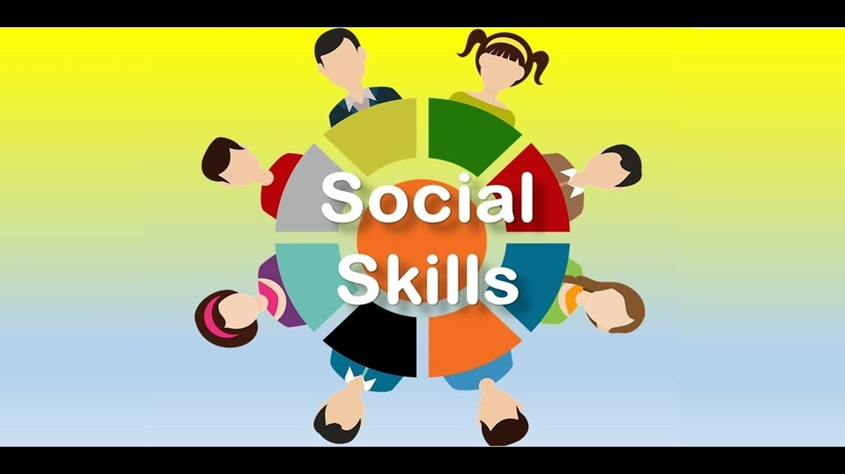
4. Social Skills

Slide 16
Why social skills are important?
Gaining ideas, information, techniques and perspectives from people with different areas of expertise
Providing your own perspective for the benefit of others
Accomplishing tasks and collaborating with others toward a shared goal
Providing mutual support for difficult or hard-to-navigate situations
Expanding your network to learn about and pursue new opportunities
Gaining feedback and referrals from people who can personally attest to your work, skills and qualities (and for whom you can do the same)
Making the workplace more enjoyable

Slide 17
Six examples of useful social skills
1. Effective Communication
2. Conflict Resolution
3. Active listening
4. Empathy
5. Relationship management
6. Respect

Slide 18
How to improve Social Skills?
Get feedback
Set goals
Find resources
Identify areas for practice

Slide 19
5. Confidence Building
Self Confidence
Self-confidence is an attitude about your skills and abilities.
You know your strengths and weakness well, and have a positive view of yourself. You set realistic expectations and goals, communicate assertively, and can handle criticism.
Self-confidence is understanding that you trust your own judgment and abilities, and that you value yourself and feel worthy, regardless of any imperfections or of what others may believe about you.

Slide 20
Confident Behaviour | Behaviour Associated with Low Self-Confidence
Doing what you believe to be right, even if others mock or criticize you for it. | Governing your behavior based on what other people think.
Being willing to take risks and to go the extra mile to achieve better things. | Staying in your comfort zone, fearing failure, and avoiding risk.
Admitting your mistakes, and learning from them. | Working hard to cover up mistakes, and hoping that you can fix the problem before anyone notices.
Waiting for others to congratulate you on your accomplishments. | Extolling your own virtues as often as possible to as many people as possible.
Accepting compliments graciously. "Thanks, I really worked hard on that prospectus. I'm pleased you recognize my efforts." | Dismissing compliments offhandedly. "Oh that prospectus was nothing really, anyone could have done it."

Slide 21
How Do You Gain Self-Confidence, and Keep It?
Building Confident Habits
Reviewing Past Achievements
Setting Confidence-Boosting Goals

Slide 22
Further……
Recognize and emphasize your strengths. Reward and praise yourself for your efforts and progress.
When you stumble on an obstacle, treat yourself with kindness and compassion. Don't dwell on failure.
Set realistic and achievable goals. Do not expect perfection; it is impossible to be perfect in every aspect of life.
Slow down when you are feeling intense emotions and think logically about the situation.
Challenge making assumptions about yourself, people and situations.
Recognize that past negative life experiences do not dictate your future.
Express your feelings, beliefs and needs directly and respectfully
Learn to say no to unreasonable requests.

Slide 23
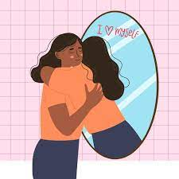
Self Esteem

Slide 24
Self Esteem
Self-esteem has to do with how worthwhile you feel.
It’s different than the idea of self-confidence, which has more to do with your ability to do something successfully.
Self-esteem has to do with your ideas about yourself.
It is based on how much you value yourself.

Slide 25
Self Esteem Issues
Some common examples of low self-esteem might include:
Hating yourself or feeling angry or frustrated about who you are.
Being obsessed with being perfect.
Hating your body.
Feeling worthless.
Being overly sensitive.
Feeling anxious and fearful.
Constantly feeling angry.
Trying to be a people pleaser.

Slide 26
Building Self Esteem
Practice mindfulness
Change your story
Don’t compare yourself to others
Channel that inner rock star
Move your body more
Volunteer
Practice forgiveness
Realize that you are not your circumstances

Slide 27
6. Attitude
According to Gordon Allport, “An attitude is a mental and neural state of readiness, organized through experience, exerting a directive or dynamic influence upon the individual’s response to all objects and situations with which it is related.”
Frank Freeman said, “An attitude is a dispositional readiness to respond to certain institutions, persons or objects in a consistent manner which has been learned and has become one’s typical mode of response.”
Thurstone said, “An attitude denotes the total of man’s inclinations and feelings, prejudice or bias, preconceived notions, ideas, fears, threats, and other any specific topic.”

Slide 28
Factors influencing attitude
Social Factors.
Direct Instruction.
Family.
Prejudices.
Personal Experience.
Media.
Educational and Religious Institutions.
Physical Factors.
Economic Status and Occupations.

Slide 29
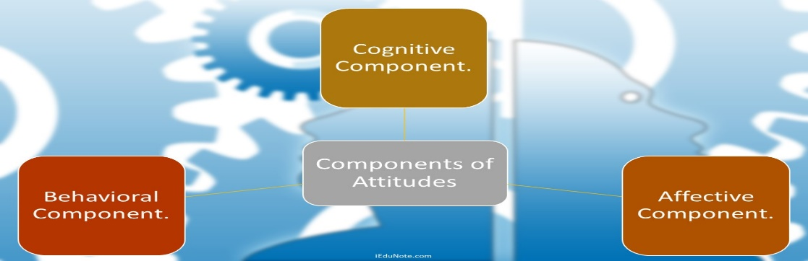
Components of Attitude
Cognitive Component.
Affective Component.
Behavioral Component.

Slide 30
Barriers to change Attitudes
Barriers to Change Attitudes are:
Prior Commitment.
Insufficient Information.
Balance and Consistency.
Lack of Resources.
Improper Reward System.
Resistance to Change.

Slide 31
7. Basic Professional Etiquette and Manners
Make a good first impression
Avoid gossip
Communication is key
Understand your work environment
Be personal yet professional
Small talk
Hand shake
Lunch meetings / Interviews
Your online presence

Slide 32
8. Johari Window

Slide 33
Thank you

